Slide 1
The challenge of making comparable international statistics
“Statistics as a trusted source of information”
Parallel session 3C:
International statistics: Beyond the simple collation of national official statistics
Julio A. Santaella President of INEGI
September 20, 2018
Notes:
20 September 2018
10:30-12:00
Parallel sessions 3.C.
International statistics: Beyond the simple collation of national official statistics
Organiser: CCSA
Chair: Stefan Schweinfest (UNSD)
Panel: Martine Durand (OECD), Angela Me (UNODC), Julio Santaella (INEGI, Mexico) panellists
The session will focus on the value of international statistics to respond to regional and global policy needs and the challenges faced by international organisations to provide internationally comparable data and indicators that are of high quality, transparent and relevant to their constituencies. Presentations and discussion will cover the perspectives of national statistical offices and international organisations on the use of national official data in international statistics and adjustments or estimates that international organisations may make to ensure comparability and consistency.

Slide 2
Social needs exist across borders and so their solutions
Our challenge today is not to save Western civilization – or Eastern, for that matter. All civilization is at stake, and we can save it only if all peoples join together in the task.
Kofi Annan

Slide 3
Users demand statistics that can be comparable among countries in order to:
Compare countries
Diagnose needs, design and evaluate policy
Move forward with the SDGs

Slide 4
Different methodologies
Official Statistics are not always comparable among countries
Different economic and social structure in each country
NSOs must fulfill specific information needs for their respective users

Slide 5
In some cases there are differences between the classifiers used

Slide 6
Mexico´s standard for classifying business establishments (NAICS)
The International Standard Industrial Classification of all Economic Activities (ISIC)
…resulting in a duplicity of work to structure information

Slide 7
In other cases international data differ from national data….

Slide 8
On issues as population…
Population of Mexico, 2010 - 2030
There is an average difference of 5.2% between the population data published by UN-DESA and Mexico´s official data published by the National Population Council:
4.8% in 2018
7.3% in 2030
projection

Slide 9
in data that is used to calculate SDG indicators…
INDICATOR 8.1.1 Annual growth rate of real GDP per capita
In this case, there is a notice to the users is that the data presented by the international organization is adjusted, however, the original country data or the methodology used is not accessible
*Country adjusted data: Produced and provided by the country, but adjusted by the international agency for international comparability to comply with internationally agreed standards, definitions and classifications;

Slide 10
in data that is used to calculate SDG indicators…
INDICATOR 16.1.1 Number of victims of intentional homicide per 100,000 population
In this example we see that the data reported by the international organization refers that is produced and disseminated by the country, nevertheless, there are small differences with the data officially reported by Mexico
*Country data - Produced and disseminated by the country
Notes:
The United Nations Office against Drugs and Crime (UNODC), collects on a yearly basis the United Nations Survey on Crime Trends and the Operations of Criminal Justice Systems (UN-CTS), in which INEGI provides statistics on police forces, public prosecution, the Criminal Justice System, and data from crime victimization and corruption surveys in Mexico, collected through the Government and Justice Censuses and Surveys.
The UN-CTS is also the vehicle that UNODC uses to collect data for the SDG 16 indicators on crime, violence and corruption. UNODC has published this data for 2016, including data for Mexico provided by INEGI.

Slide 11
Challenge for international organizations

Slide 12
EX-ANTE
In order to minimize adjustments and achieve comparability, the work has to be done ex ante, in international working groups, where the methodologies must be defined and later applied by countries
EX-POST
International Organizations need to adjust figures for comparability reasons and define ad-hoc adjustment procedures for different countries
Provide comparable statistical information from different countries

Slide 13
The role of the NSS, NSOs and International Agencies must be clearly defined and accepted by the different players to avoid discrepancies in the information

Slide 14
Commitments have to be made by both parties
Take into account the information needs of international users
Generate official statistics that are internationally comparable
Contribute with their knowledge in international working groups and adopting their methodologies and best practices
Make transparent and replicable the adjustment procedure used to adjust figures
Report both the original NSO´s figure and the adjusted one
Respect the role of NSOs as suppliers of official statistics and coordinators of the National Statistical Systems
National Statistical Offices
International Agencies

Slide 15
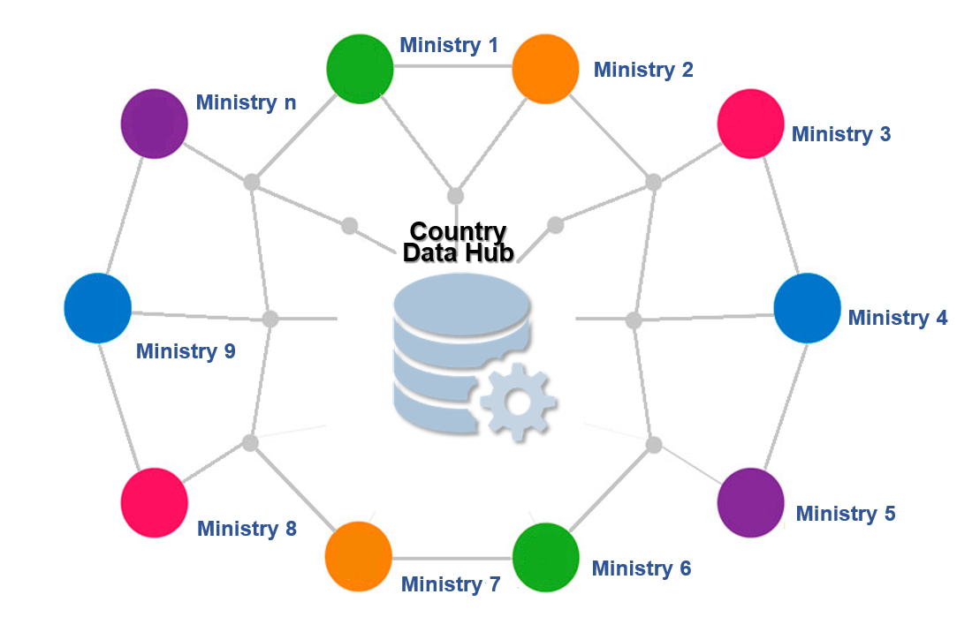
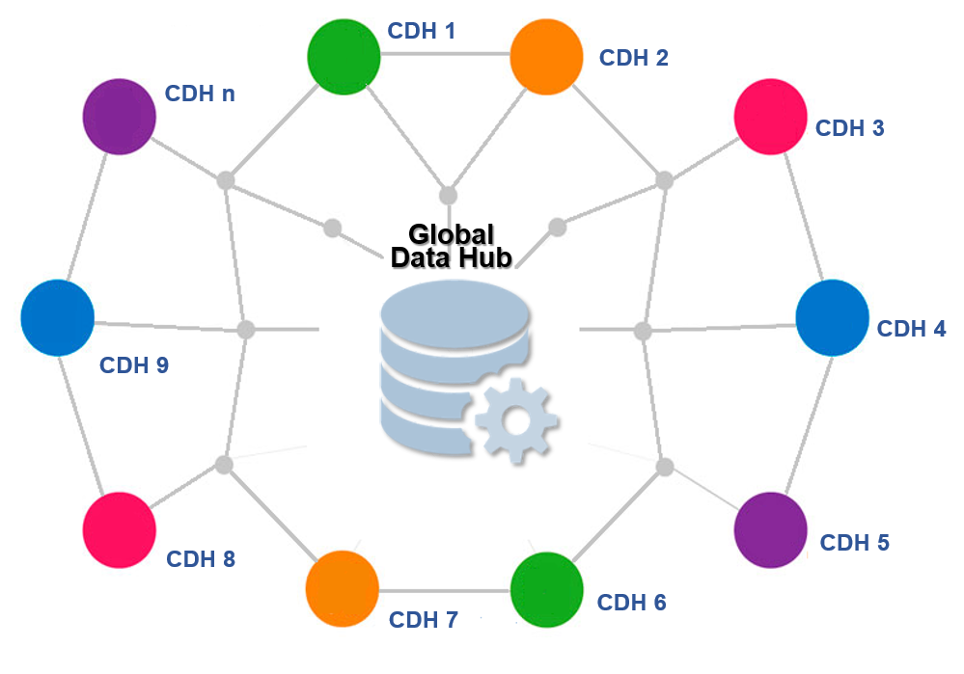
We must work to consolidate and broaden the use of Data Hubs
Prototypical Country Data Hub
Prototypical Country Data Hub
Data flows from countries to international agencies could originate from either Ministry n or the correspondent CDHn
Getting it from the CDH would make information pulls easier and standardized.

Slide 16
Which are the official data from an international point of view?
Who is responsible for making the information comparable?

Slide 17
The challenge of making comparable international statistics
“Statistics as a trusted source of information”
Parallel session 3C:
International statistics: Beyond the simple collation of national official statistics
Julio A. Santaella President of INEGI
September 20, 2018
Notes:
20 September 2018
10:30-12:00
Parallel sessions 3.C.
International statistics: Beyond the simple collation of national official statistics
Organiser: CCSA
Chair: Stefan Schweinfest (UNSD)
Panel: Martine Durand (OECD), Angela Me (UNODC), Julio Santaella (INEGI, Mexico) panellists (tbc)
The session will focus on the value of international statistics to respond to regional and global policy needs and the challenges faced by international organisations to provide internationally comparable data and indicators that are of high quality, transparent and relevant to their constituencies. Presentations and discussion will cover the perspectives of national statistical offices and international organisations on the use of national official data in international statistics and adjustments or estimates that international organisations may make to ensure comparability and consistency.

